Slide 1
ML Model Evaluation
By Shruti Biswas

Slide 2
Summary
Statistical Summary
Class Distribution
Data Visualization
MODEL SELECTION
ALGORITHM COMPARISON
ACCURACY OF MODEL

Slide 3
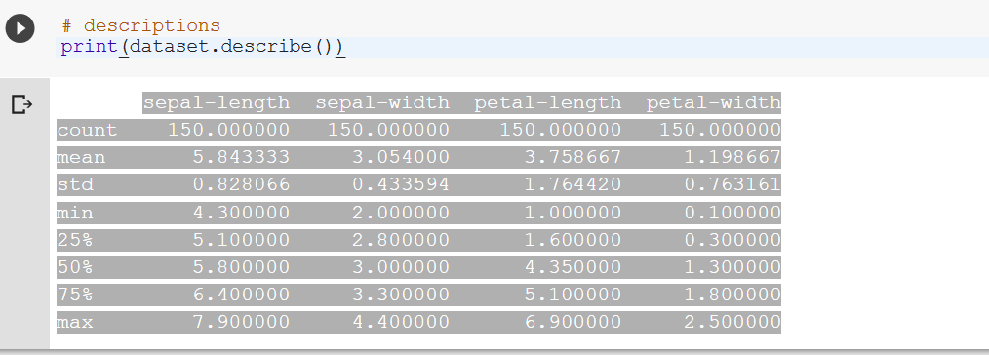
Statistical Summary
This includes the count, mean, the min and max values as well as some percentiles.

Slide 4
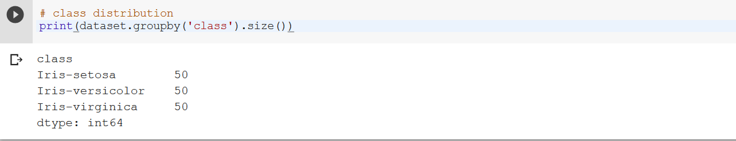
Class Distribution
Let’s now take a look at the number of instances (rows) that belong to each class. We can view this as an absolute count.

Slide 5
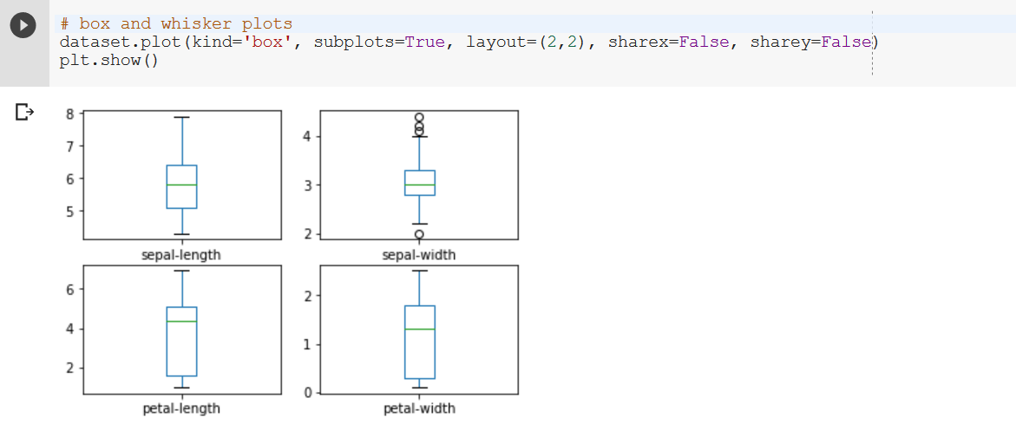
Data Visualization
Univariate Plots
This gives us a much clearer idea of the distribution of the input attributes:

Slide 6
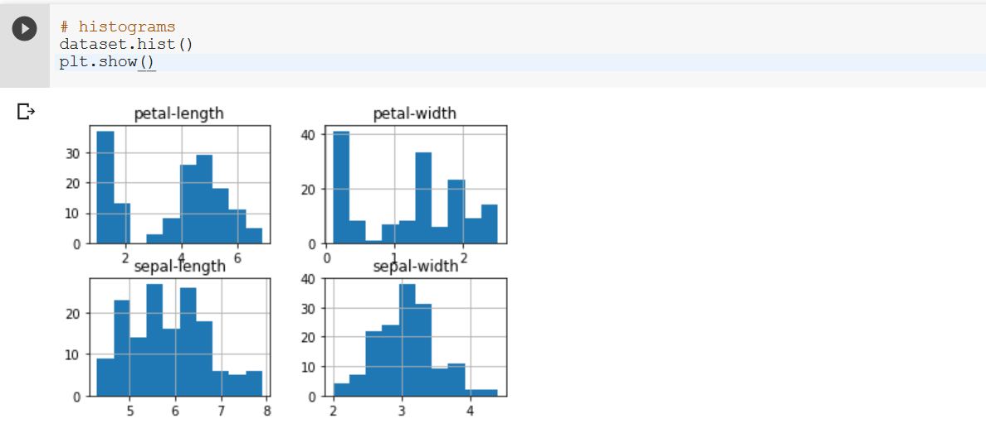
Data Visualization
Histogram Plots
Create a histogram of each input variable to get an idea of the distribution. It looks like perhaps two of the input variables have a Gaussian distribution. This is useful to note as we can use algorithms that can exploit this assumption

Slide 7
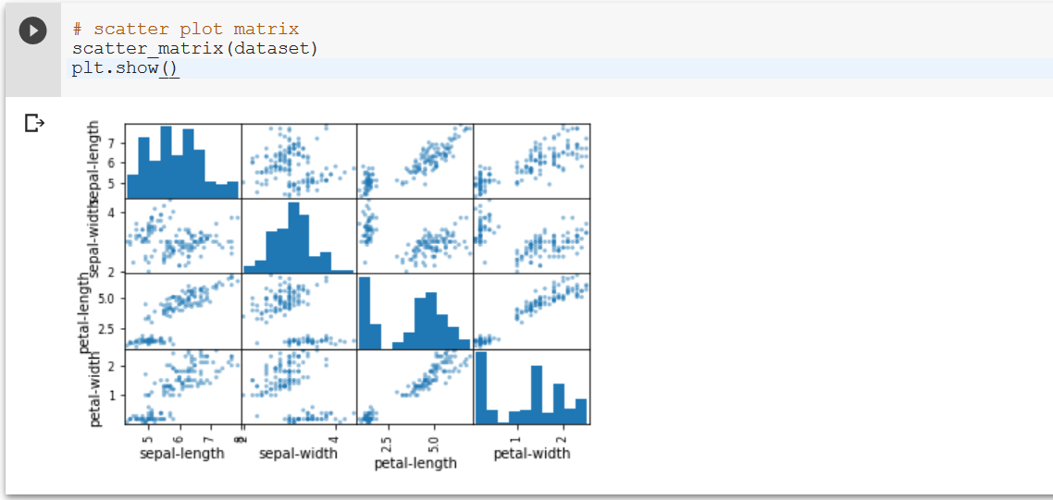
Multivariate Plots
This can be helpful to spot structured relationships between input variables.
This suggests a high correlation and a predictable relationship.

Slide 8
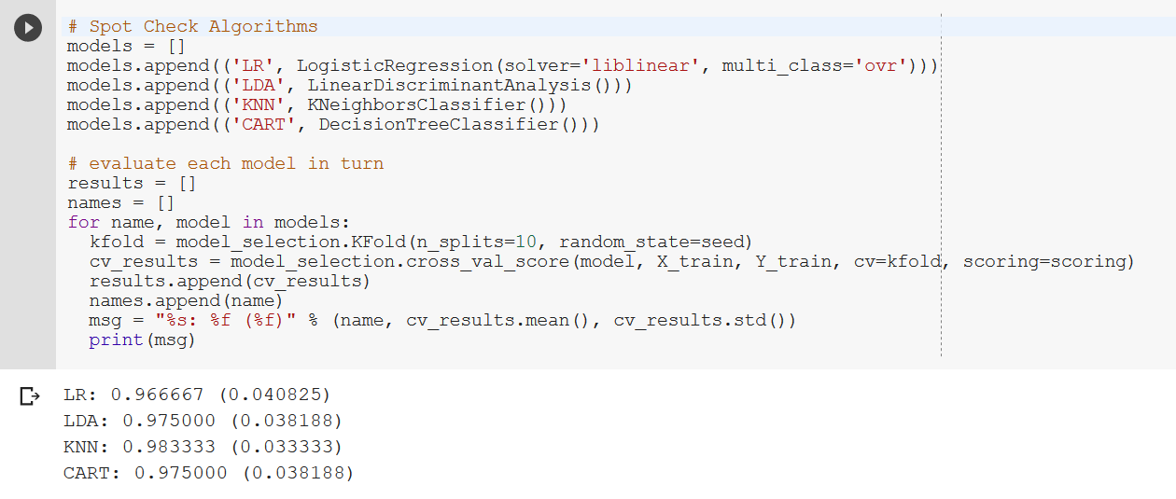
Select Best Model
we can see that it looks like KNN has the largest estimated accuracy score..

Slide 9
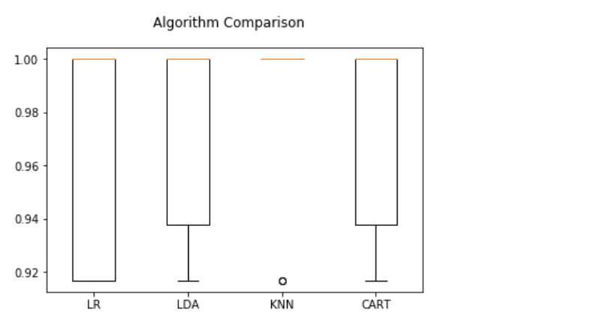
Compare Algorithms
The KNN algorithm is very simple and was an accurate model based on our tests

Slide 10
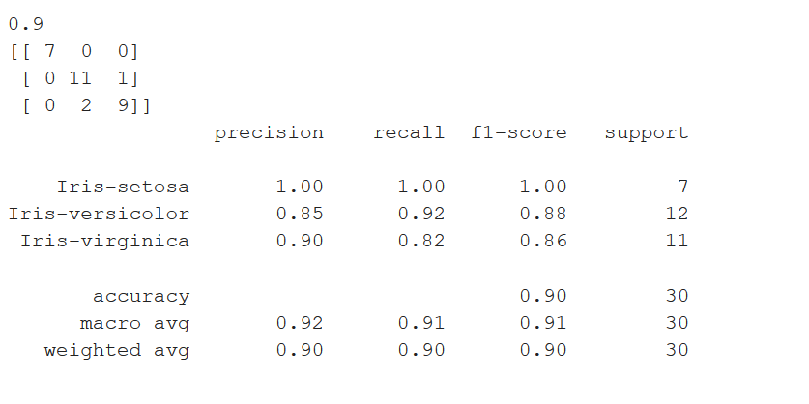
Accuracy of Model on validation dataset
This will give us an independent final check on the accuracy of the best model. It is valuable to keep a validation set just in case you made a slip during training, such as overfitting to the training set or a data leak. Both will result in an overly optimistic result.
We can see that the accuracy is 0.9 or 90%. The confusion matrix provides an indication of the three errors made. Finally, the classification report provides a breakdown of each class by precision, recall, f1-score and support showing excellent results (granted the validation dataset was small).

